Slide 1



Slide 2
LOG IN
SIGN UP
Copyright @ Team GuageLander 2019

Slide 3




Explore a new language every day!
Email
Password
LOG IN
Or Log in with

Slide 4
Welcome to GuageLand!
Email
Password
Re-enter Password
SIGN UP

Slide 5





5 main pages:
Findings
Chatbots
Discovery
Personal Land
Profile
Findings
TODAY’S POPULAR

Slide 6


Chatbots
Hi, How can I help you?
How can I use my points?
You can use them to claim reward…
………..
oh that’s easy…..

Slide 7


Discovery
10234 Indigenous Languages
in our GuageLand

Slide 8
Personal Land
Your Guageland: Lv 6
Designing…

Slide 9


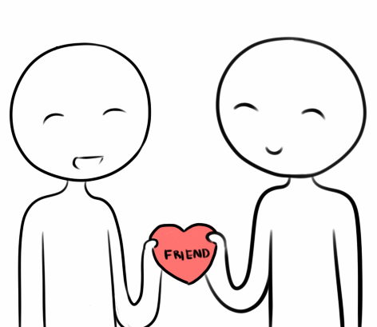


Profile
Alice Lee
Lv. 6
Tasks
Favorites
Circles
My Posts
Rewards

Slide 10




Profile
1
Albi
Bulgri
Basic Info
Current Viewing Language
Expert Lv 7
Alice Lee
200
$ 500
Donation
3 Trips
Claimed
Signature
Build the shape of language.
Region
Singapore
45 Countries
Footprint
302 Languages
Viewed
Who views your profile

Slide 11
Profile
1
1
Unread Msg
Unread Message
Yesterday 14:23
Alice Lee
Robot sends you a Friend Request!
200
Signature
Build the shape of language.
Region
Singapore
Who views your profile

Slide 12

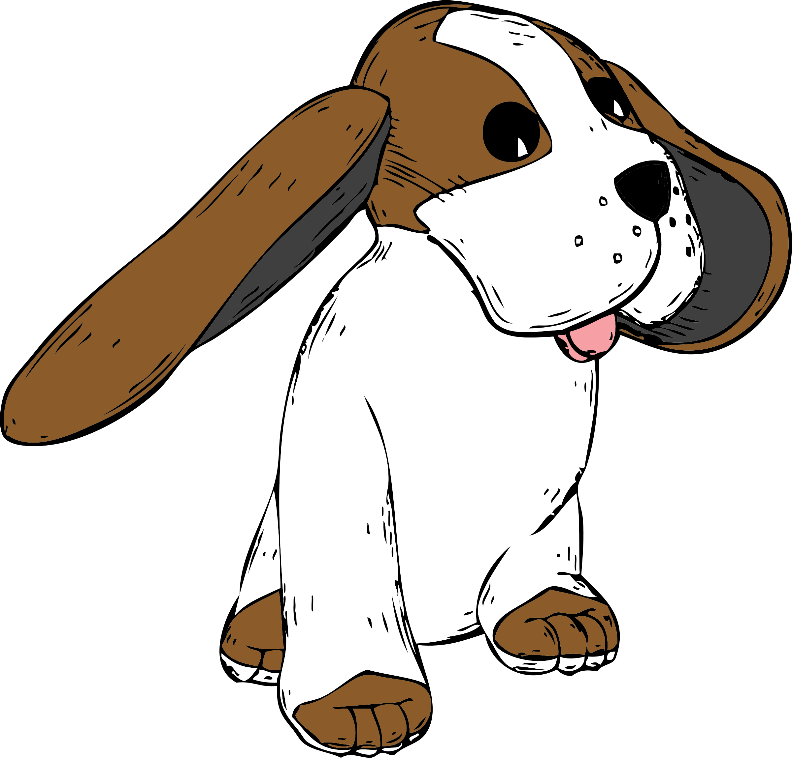

+
Other Users’ Profile
$ 500
Donation
3 Trips
Claimed
When click their profile images in the Findings’ article
Send Friend Request
45 Countries
Footprint
302 Languages
Viewed
Bob John
Malaysia
Build the shape of world!
Caldse
Xseus
His Latest Post
Current Viewing Language
Beginner Lv 2
/Navajo Word of the Day - "I Love You”

Slide 13




Other Language Organizations’ Profile
Organization
LOGO
$ 499,324
Donation Received
536
Article
Posts
(Follow)
When click their profile images in the Findings’ article
Latest Post
Endangered Language Project
http://www.endangeredlanguages.com
Supporting and celebrating global linguistic diversity!
/Navajo Word of the Day - "I Love You”
Introduction
feedback@endangeredlanguages.com
The Endangered Languages Project puts technology at the service of the organizations and individuals working to confront the language endangerment by documenting, preserving and teaching them.
N/A
N/A

Slide 14


Profile
<
<
200
Tasks on Your Land
Task
Chat with Bot Twice
50
200
Make 2 new friends
100
Paper plane Wandering
15
Tasks Completed
Quiz
30
Daily Attendance
16 March 2019
10
Sharing your language
100
Chat with Bot Twice
50

Slide 15
<
Profile
Favorites
4
Favorites
Post 234 of Language A
Post 456 of Language b
Post 789 of Language D
14/05/2018 Chat History

Slide 16

<
<
Profile
5
/Navajo Word of the Day - "I Love You”
Since today is Valentine's Day, I decided to make today's Navajo Word of the Day
"Ayóó'ánííníshní,”
which means,
"I Love You!"
Favorites
Circles
Today’s share
Today
14:13
<
<
User pic who posts
/Navajo Word of the Day - "I Love You”
when click
when click

Slide 17
Profile
Circles
/Navajo Word of the Day - "I Love You”
____________
Since today is Valentine's Day, I decided to make today's Navajo Word of the Day
"Ayóó'ánííníshní,”
which means,
"I Love You!"
/Navajo Word of the Day - "I Love You”
____________
Since today is Valentine's Day, I decided to make today's Navajo Word of the Day
"Ayóó'ánííníshní,”
which means,
"I Love You!"
< Your Friends
when click
the forward button

Slide 18

Profile
<
<
Quiz
QUIZ
QUIZ
Count down
Picture
A
B
Question 1
C
D
A
B

Slide 19


Profile
<
200
Rewards
We have 9 rewards kinds:
50 points,
100 points,
200 points,
500 points,
1000 points,
2000 points,
5000 points,
10000 points
15000 points
50 points
100 points
200 points
10000 points
15000 points

